Slide 1

KLE Technological University
Files
II Semester
18ECSP102– Problem Solving with Data Structures
Files
2021-2022

Slide 2
Files
Introduction
Collection of data or information that are stored on a computer known as file.
File is a collection of bytes stored on a secondary storage device.
There are four different types of file.
Data files
Text files
Program files
Directory files
Different types of file store different types of information.

Slide 3
Files
Types of files
ASCII text file
A text file can be a stream of characters that a computer can process sequentially.
It is processed only in forward direction.
Binary file
A binary file is a file consisting of collection of bytes.
A binary file is also referred to as a character stream

Slide 4
Files
Steps in processing a file
Create the stream via a pointer variable using the FILE structure. Ex: FILE *p;
Open the file, associating the stream name with the file name.
Read or write the data.
Close the file.

Slide 5
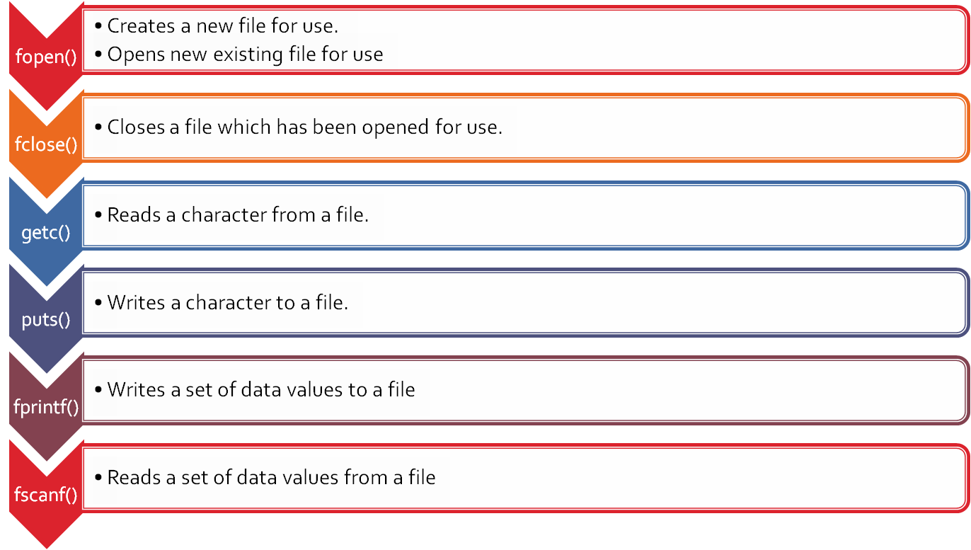
Files
File Functions

Slide 6
Files
Naming a file
file is identified by its name.
This name is divided into two parts
File Name
It consists of alphabets and digits.
Special characters are also supported, but it depends on the operating system we use.
Extension
It describes the file type

Slide 7
Files
File Pointer
The file pointer is a pointer variable which can be store the address of a special file that means it is based upon the file pointer a file gets opened.
Declaration of a file pointer:-
FILE* var;
Note:
The last byte of a file contains the end-of-file character (EOF),
While reading a text file, the EOF character can be checked to know the end.

Slide 8
Files
File Modes
Mode | Meaning
r | Open a text file for reading only. If the file doesn’t exist, it returns null.
w | Opens a file for writing only. If file exists, than all the contents of that file are destroyed and new fresh blank file is copied on the disk and memory with same name If file dosen’t exists, a new blank file is created and opened for writing. Returns NULL if it is unable to open the file
a | Appends to the existing text file Adds data at the end of the file. If file doesn’t exists then a new file is created. Returns NULL if it is unable to open the file.

Slide 9
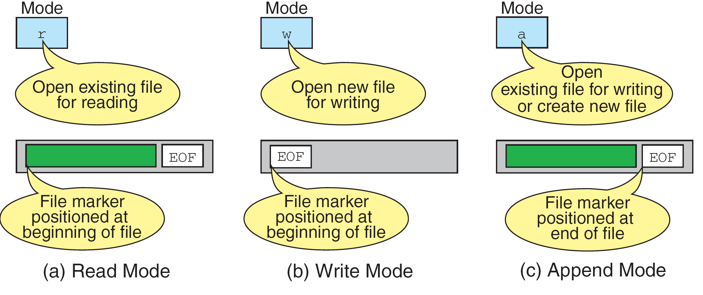
Files
File Modes

Slide 10
Files
Additional Modes
r+ :open for reading and writing, start at beginning
w+ : open for reading and writing (overwrite file)
a+ :open for reading and writing (append if fileexists)
Three special file streams are defined in the <stdio.h> header
– stdin :reads input from the keyboard
– stdout :send output to the screen
– stderr :prints errors to an error device (usually also the screen)

Slide 11
Files
Opening a file
Before performing any type of operation, a file must be opened and for this fopen() function is used.
file-pointer=fopen(“FILE NAME ”,”Mode of open”);
Example: FILE *fp=fopen(“ar.c”, ”r”);
If fopen() unable to open a file then it will return NULL to the file pointer.

Slide 12
Files
Closing a file
To close a file and dis-associate it with a stream (file pointer), use fclose() function.
fclose(FILE *fp)
fclose() returns 0 if the file is closed successfully.
fcloseall() closes all the files opened previously.

Slide 13
Files
End of file (EOF)
Generally, a file contains a large amount of data.
In a large file, it is difficult to detect the end of file while reading.
In order to mark the end of a text file, a special character EOF is stored at the end.

Slide 14
Files
Input/Output operations on files
getc() – read a character
putc() – write a character
fprintf() – write set of data values
fscanf() – read set of data values
getw() – read integer
putw() – write integer

Slide 15
Files
getc()
identifier = getc (file pointer);
Example:
FILE *fp;
fp=fopen(“input.txt”,”r”);
char ch;
ch = getc (fp);

Slide 16
Files
putc()
putc (variable,file pointer);
write a single character to the output file, pointed to by fp.
Example:
FILE *fp;
char ch;
putc (ch,fp);

Slide 17
Files
fprintf()
fprintf (fp,"string",variables);
Example:
int i = 12;
float x = 2.356;
char ch = 's';
FILE *fp;
fp=fopen(“out.txt”,”w”);
fprintf (fp, "%d %f %c", i, x, ch);

Slide 18
Files
fscanf()
fscanf (fp,"string",identifiers);
Example:
FILE *fp;
fp=fopen(“input.txt”,”r”);
int i;
fscanf (fp,“%d",i);

Slide 19
Files
Application of files
Mr. Ram works in KLETU as a covid task force manager and wants to know the student list who have taken the covid vaccination. To find out the student list, he uses a file to store the students' information and then print the student list who have taken the covid vaccination. Please help Mr. Ram to solve the problem.

Slide 20
Files
Writing student details to the file
void write(FILE *fp)
{
char student_name[10];
int student_id,vaccinated,n,i;
fp=fopen("vaccine.txt","w");
printf("Enter the number of students\n");
scanf("%d",&n);
for(i=1;i<=n;i++)
{
printf("Enter the student ID\n");
scanf("%d",&student_id);
printf("Enter the student name\n");
scanf("%s",student_name);
printf("is student vaccinated if yes press 1 else 0\n");
scanf("%d",&vaccinated);
if(i!=n)
fprintf(fp,"%d\t%s\t%d\n",student_id,student_name,vaccinated);
else
fprintf(fp,"%d\t%s\t%d",student_id,student_name,vaccinated);
}
fclose(fp);
}
#include<stdio.h>
#include<stdlib.h>
#include<string.h>
void write(FILE *fp);
void read(FILE *fp);
void Vaccinated_students(FILE *fp);
void main()
{
FILE *fp;
write(fp);
read(fp);
Vaccinated_students(fp);
}

Slide 21
Files
Reading Student details from the file
Reading student details from the file
Display vaccinated student details from the file
void read(FILE *fp)
{
int student_id,vaccinated;// vaccinated=1 else 0
char student_name[10];
fp=fopen("vaccine.txt","r");
while(!feof(fp))
{
fscanf(fp,"%d%s%d",&student_id,student_name,&vaccinated);
printf("student ID= %d\n",student_id);
printf("student name= %s\n",student_name);
printf("student vaccinated_status =%d\n",vaccinated);
}
fclose(fp);
}
void Vaccinated_students(FILE *fp)
{
char student_name[10];
int student_id,vaccinated;
printf("\n\nDisplaying vaccinated students\n");
fp=fopen("vaccine.txt","r");
while(!feof(fp))
{
fscanf(fp,"%d%s%d",&student_id,student_name,&vaccinated);
if(vaccinated==1)
{
printf("student ID= %d\n",student_id);
printf("student name= %s\n",student_name);
printf("student RAM =%d\n",vaccinated);
}
}
fclose(fp);
}

Slide 22
Files
Thank You

